Slide 1

SMART VIRTUAL HACKATHON - 2020
PROBLEM STATEMENT: Social Distancing Monitoring App
COLLEGE: SSN College of Engineering
TEAM NAME: Apocalypse
MENTOR: Dr. L Suganthi
TEAM MEMBERS: Gurucharan M K
Ansar Ahamed S
Rajkumar A J
Bharathraaj N

Slide 2
ABSTRACT and IDEA
Due to COVID-19, people are forced to maintain a sufficient amount of distance between each other to prevent the spread of this deadly virus.
Social Distancing has proven to be a successful method in containing the spread of COVID-19.
Tracking and Monitoring the practice of Social Distancing in public areas such as malls, theatre halls and shops has become increasingly important to control the spread.
An app to monitor Social Distancing in public places would be helpful in controlling its spread and giving an output result by counting the number of people not adhering to it in that area.
DISCLAIMER: This is not a Social Distancing app that notifies individuals on Social Distancing Violation. It is meant only to be used for Monitoring Purposes.

Slide 3
TECHNOLOGY USED
Software and Frameworks Used
Python Language
Deep Learning – YOLO v3 Object Detection with COCO Labels
OpenCV (Computer Vision)
Kivy UI Design (For App UI Design and Development)
GITHUB REPOSITARY LINK
https://github.com/mk-gurucharan/Social-Distance-Monitoring---SVH2020

Slide 4
SAMPLE MONITORING
INPUT VIDEO
OUTPUT VIDEO

Slide 5
OBJECTIVE
The main objective is to only monitor the people from a remote location if proper social distancing norms are followed.
To Replace or Assist the Police Force and Man Power (Security Force) with this task by a software to monitor people will surely be of great help.
It also has real-time monitoring which is more efficient.
Incorporating this software in all government and private monitoring CCTV cameras will notify people concerned if the norms are violated.
It is a promising ideology to safeguard our people from this pandemic.

Slide 6
METHODOLOGY
An app will be designed using Kivy UI Library in Python
The program to monitor the practice of Social Distancing in a crowd will be developed with Python Language.
The input to the program code will be the Live Video captured from the Mobile Phone Camera or from the CCTV.
The video will be split into individual frames. In each frame, the people in that image will be detected and become bounded by a rectangle box.
The centre of the rectangle box for each individual person will be determined.
After detecting the centre point, the distance between all the centre points will be calculated in a loop and those distances that are smaller than a set threshold will be identified.
The rectangle boxes of the individuals that are identified above will be marked with a red boundary indicating that social distancing is violated and the other rectangular boxes will be marked with a green boundary indicating that the person is following social distancing.
This output can be viewed from the App developed.
Software and Framework Used –
Python
OpenCV
Kivy UI
Deep Learning

Slide 7
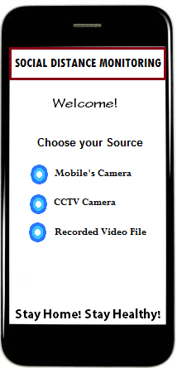
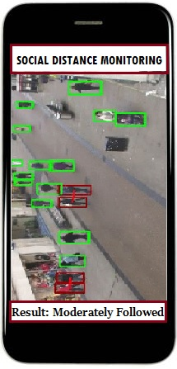
SAMPLE INTERFACE
SAMPLE HOME SCREEN
SAMPLE OUTPUT

Slide 8
Design an application uusing Arduino studio
FLOW DIAGRAM
Customize and design an uder-friendly interface
Mobile camera
User’s choice of video source
Video from gallery
Integrating android studio and python
Live CCTV footage
Checking whether the social distancing is maintained or not
They are marked in green box
YES
NO
They are marked in red box

Slide 9
IMPACT AND CONCLUSION
This app can be used to monitor social distancing in public places such as malls and offices from the CCTV Cameras installed.
It can also be used in Schools and Colleges to monitor the students.
Another application is in theatre halls, where this can be used to capture photos of the people to check the practice of Social Distancing at regular intervals
It can also be used to show a proof to the owners of Shops or Areas where lockdown is to be enforced in case they question the violation of Social Distancing in their area.
A counter can also added to count the number of people violating the social distancing norms which can be analysed to deploy more security to control the violation.
The app developed will be an easy to use interface by which each even a common security guard can monitor the social distancing from his mobile phone.

Slide 10
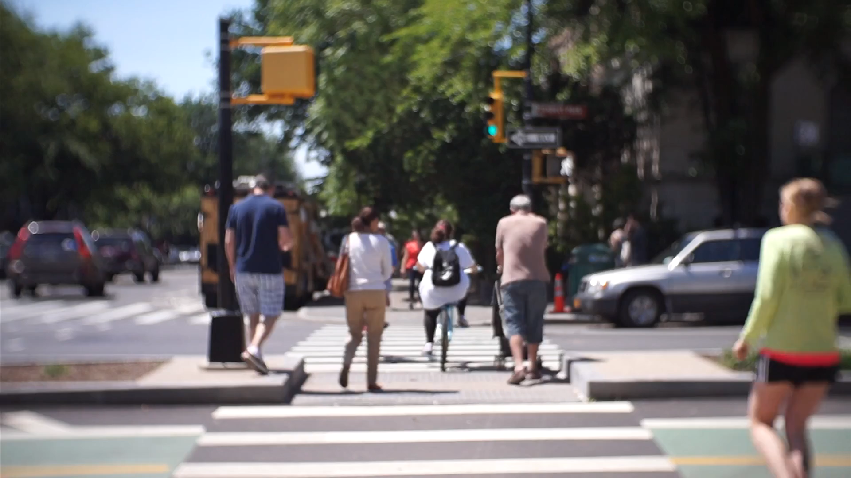
Social Distance Monitoring Using Recorded Video
Input Video Followed by Output Result

Slide 11

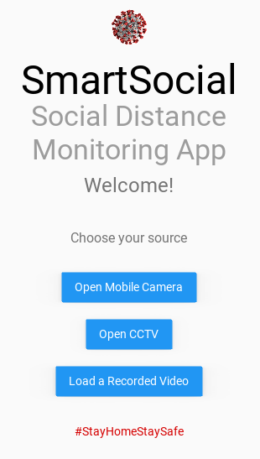

APP INITIAL WORKING
APP UI

Slide 12
OVERALL APP UI DEVELOPED

Slide 13
WORK DONE – 3rd Round of Evaluation
The Social Distancing Monitoring Program has been successfully implemented for a recorded video sample and is displayed.
The Social Distancing Monitoring Program has been successfully implemented for a PC Webcam and is displayed.
The App UI has been designed and is shown.
The Deep Learning Code (Social Distance Monitoring) is incorporated with the App UI Designed and is displayed.
TO BE DONE by Next Evaluation
To work on developing the apk file and importing the app to our mobile phones.
To fine-tune the App UI for more easy usage.

